Slide 1
Oracle Cloud – Deploying a secure 3-tier application on Oracle Cloud Infrastructure (OCI)

Slide 2
Agenda:
Objective
Register for Oracle Cloud Trial & Free Tier
What is the Oracle Cloud Free Tier
Copyright © 2019 Oracle and/or its affiliates.

Slide 3

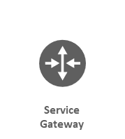
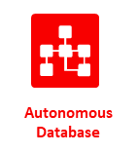

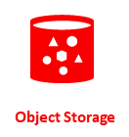
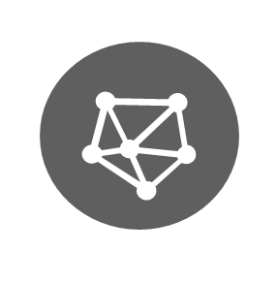
Goal: Implement this architecture in OCI
ORACLE CLOUD INFRASTRUCTURE (REGION)
VCN
Availability Domain
Internet Gateway
Public Subnet
Private Subnet
NAT Gateway
Route Table
Load Balancer
Route Table
Application Node
Security Lists
Security Lists
Bastion Host

Slide 4
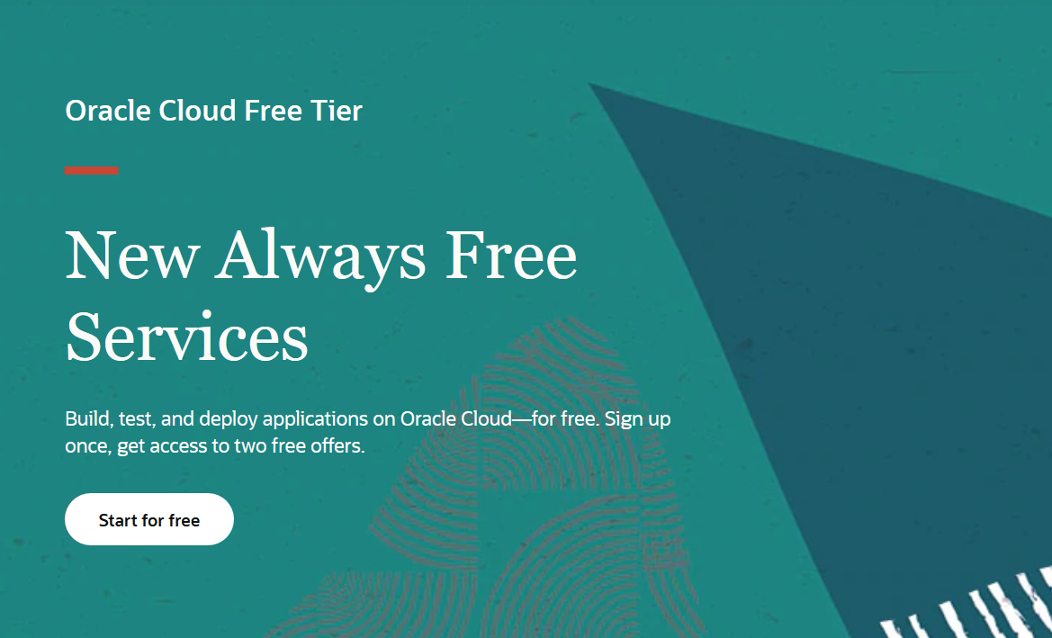
Notes:
https://www.oracle.com/cloud/free/#always-free

Slide 5
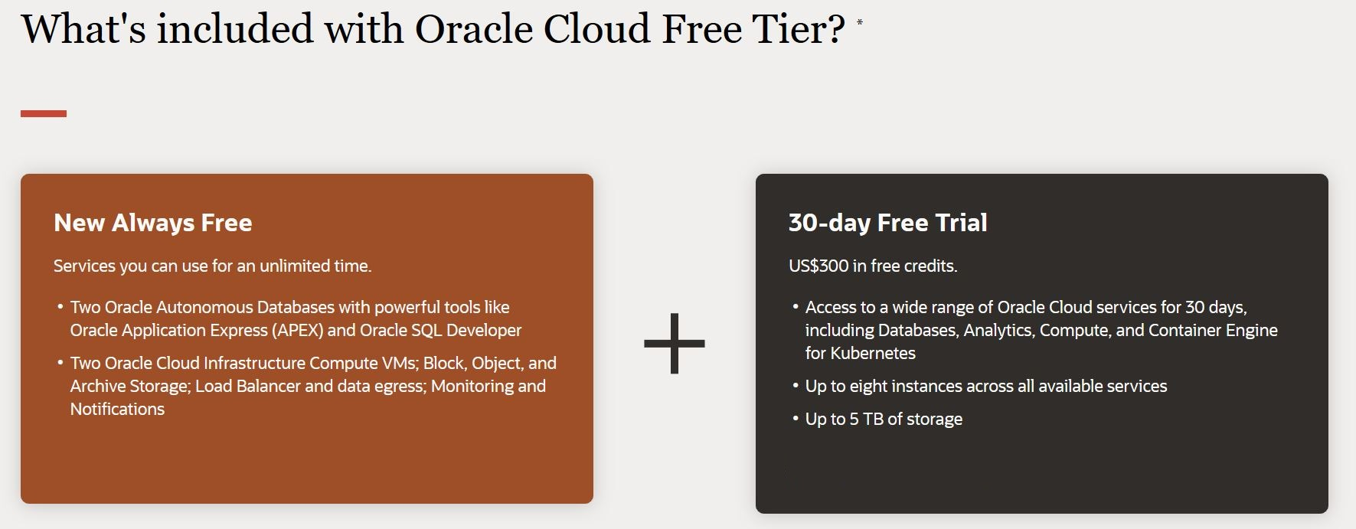

Slide 6
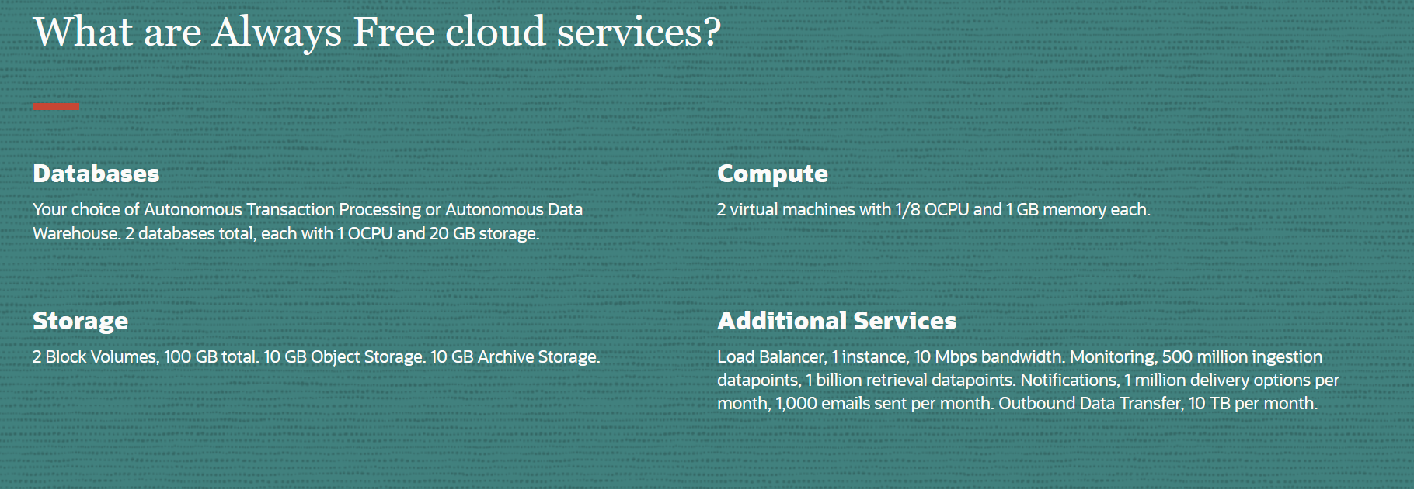

Slide 7
Let’s start from the beginning
ORACLE CLOUD INFRASTRUCTURE (REGION)
VCN
Availability Domain
Internet Gateway
Public Subnet
Private Subnet
NAT Gateway
Route Table
Load Balancer
Route Table
Application Node
Security Lists
Security Lists
Bastion Host

Slide 8
Creating the VCN
ORACLE CLOUD INFRASTRUCTURE (REGION)
VCN
CIDR: 10.0.0.0/16
Notes:
What is a VCN?
Virtual version of a traditional network

Slide 9
Creating the public subnet
ORACLE CLOUD INFRASTRUCTURE (REGION)
VCN
Availability Domain
Internet Gateway
Public Subnet
CIDR: 10.0.1.0/24
Route Table
Security Lists

Slide 10
Firstly, let’s create the required components:
Internet Gateway for inbound and outbound internet connectivity
Internet Gateway
Route Table for routing traffic inside and outside the VCN
Route Table
Security List for allowing ingress and egress traffic to and from the subnet
Security Lists

Slide 11
Creating the Bastion Host
ORACLE CLOUD INFRASTRUCTURE (REGION)
VCN
Availability Domain
Internet Gateway
Public Subnet
Route Table
Security Lists
Bastion Host

Slide 12
… but, first we need a pair of OpenSSH keys

Slide 13
Creating the Autonomous Database
ORACLE CLOUD INFRASTRUCTURE (REGION)
VCN
Availability Domain
Internet Gateway
Public Subnet
Route Table
Security Lists
Bastion Host

Slide 14
Oracle Wallet is a container that stores authentication and signing credentials. Trusted certificates are stored in the Oracle Wallet when the wallet is used for security credentials.
What is a Database Wallet?

Slide 15
We’ll use Object Storage Pre-Authenticated requests to make the wallet downloadable to the Application Node, securely, through the Service Gateway.
Why are we uploading it to Object Storage?

Slide 16
Creating the private subnet
ORACLE CLOUD INFRASTRUCTURE (REGION)
VCN
Availability Domain
Internet Gateway
Public Subnet
Private Subnet
NAT Gateway
CIDR: 10.0.1.0/24
Route Table
Route Table
CIDR: 10.0.2.0/24
Security Lists
Security Lists
Bastion Host

Slide 17
Required components:
NAT Gateway to allow the instances to access the internet – inbound traffic will not be possible
NAT Gateway
Service Gateway to allow traffic from the VCN to Database & Object Storage services without passing through the internet
Security List & Route table
Route Table
Security Lists

Slide 18
Creating the application node & deploying the application
ORACLE CLOUD INFRASTRUCTURE (REGION)
VCN
Availability Domain
Internet Gateway
Public Subnet
Private Subnet
NAT Gateway
Route Table
Route Table
Application Node
Security Lists
Security Lists
Bastion Host
Notes:
#cloud-config
write_files:
- path: /etc/environment
permissions: 0777
content: |
LD_LIBRARY_PATH=/usr/lib/oracle/18.3/client64/lib:$LD_LIBRARY_PATH
runcmd:
- mkdir idcs-sample-app
- cd idcs-sample-app/
- [ wget, --output-document=idcsapp2.zip, "https://objectstorage.eu-frankfurt-1.oraclecloud.com/p/YCbO7RYzKscSU5uOemIGon9SOiz948NMzzO_3BV2sN4/n/frvly4ywct1p/b/security/o/idcsapp2.zip"]
- unzip idcsapp2.zip
- touch /idcs-sample-app/python/.env
- echo "CONSTRING=admin/oracleORACLE123@security_high" >> /idcs-sample-app/python/.env
- systemctl stop firewalld
# - bash firewall.sh
- sudo yum install -y python-pip
- sudo python -m pip install "django<2"
- pip install -r requirements.txt
- pip install cx_Oracle
- yum install -y oracle-instantclient18.3-basic.x86_64
- yum install -y oracle-instantclient18.3-devel.x86_64
- yum install -y oracle-instantclient18.3-sqlplus.x86_64
- yum install -y oracle-instantclient18.3-tools.x86_64
- [ wget, "https://objectstorage.eu-frankfurt-1.oraclecloud.com/p/bEIRP-U7NiU1KgCWWPvm8JoE-sRnTZ1gLvnIAccYxCo/n/frvly4ywct1p/b/security/o/Wallet_security_3.zip", -P, /usr/lib/oracle/18.3/client64/lib/network/admin]
- [ unzip, /usr/lib/oracle/18.3/client64/lib/network/admin/Wallet_security_3.zip, -d, /usr/lib/oracle/18.3/client64/lib/network/admin/]
- echo "export LD_LIBRARY_PATH=/usr/lib/oracle/18.3/client64/lib:$LD_LIBRARY_PATH" >>/home/opc/.bash_profile
- echo "cd /idcs-sample-app" >> /home/opc/.bash_profile
- export LD_LIBRARY_PATH=/usr/lib/oracle/18.3/client64/lib:$LD_LIBRARY_PATH
- echo "export LD_LIBRARY_PATH=/usr/lib/oracle/18.3/client64/lib:$LD_LIBRARY_PATH" >>/etc/bashrc
- source /etc/bashrc
- nohup python /idcs-sample-app/manage.py runserver 0.0.0.0:8080 &
Collapse

Slide 19
Connecting to the Application Node is only possible through the Bastion Host
Keep in mind

Slide 20
Creating the Load Balancer
ORACLE CLOUD INFRASTRUCTURE (REGION)
VCN
Availability Domain
Internet Gateway
Public Subnet
Private Subnet
NAT Gateway
Route Table
Load Balancer
Route Table
Application Node
Security Lists
Security Lists
Bastion Host

Slide 21
Note:
The Load Balancer can automatically configure the VCN to add Security Rules for allowing connections to be established
Notes:
sudo yum install -y httpd sudo systemctl enable httpd sudo systemctl start httpd sudo firewall-cmd --permanent --zone=public --add-port=80/tcp sudo firewall-cmd --reload echo "<p>This is Application Server - 1</p>" > /var/www/html/index.html

Slide 22
And use the resources for a second application node instead
ORACLE CLOUD INFRASTRUCTURE (REGION)
VCN
Availability Domain
Internet Gateway
Public Subnet
Private Subnet
NAT Gateway
Route Table
Route Table
Application Node - 1
Load Balancer
Security Lists
Security Lists
Application Node - 2

Slide 23
Thanks!

